Slide 1

Department of Computer Science and Engineering
Organizes
CS23533-FOUNDATIONS OF ARTIFICIAL INTELLIGENCE
NEON CYBER-GRID : PAYLOAD ESCORT
College Name: RAJALAKSHMI ENGINEERING COLLEGE
Presented By:
240701088 - B R CHARISHMA PRIYADARSHINI
240701098 - DEEBAC Y K

Slide 2
List of Content
Abstract
Introduction
Literature Survey
Problem Statement
Proposed work
System Architecture
Methodology
Results and Discussions
Conclusion
References

Slide 3
Abstract
The Neon Cyber-Grid: Payload Escort project is an interactive web-based simulation that demonstrates secure data packet routing through hostile network environments using Artificial Intelligence (AI) algorithms. The player guides a valuable data packet from the source to its destination while avoiding threats from an adversary called the “Grid Master.”The system uses Uniform Cost Search (UCS) and A Search* for optimal pathfinding and Alpha-Beta Pruning for adversarial decision-making. Developed using HTML5, CSS3, and JavaScript, the application provides real-time route calculation, threat monitoring, and telemetry tracking. This project demonstrates how AI algorithms can improve network routing and security in dynamic threat environments.

Slide 4
Introduction
An interactive AI-based simulation that demonstrates secure data routing through hostile network environments.
Guide a valuable data packet from its source to an upload server while avoiding cyber threats.
Uses Uniform Cost Search (UCS) and A Search* to find optimal routes and minimize routing costs.
Uses Alpha-Beta Pruning to control the hostile opponent, known as the “Grid Master”.

Slide 5
Literature Survey
Approach | Main idea | Limitation
Breadth-First Search | Expands level by level; fewest edges | Ignores distances, so not the shortest path
Dijkstra (1959) | Expands the lowest-cost node first; optimal | Explores in all directions, no goal knowledge
Greedy Best-First | Uses only h(n) to head towards the goal | Fast, but not guaranteed optimal
A* (Hart et al., 1968) | f(n) = g(n) + h(n); optimal when h is admissible | Needs a good heuristic (we use straight-line distance)
Alpha-Beta Pruning | Prunes unpromising branches in minimax trees. | Requires a well-defined state evaluation function.
Our choice: Our Choice: UCS , A alpha -beta - Optimal pathfinding paired with adversarial game theory.

Slide 6
Problem Statement
The network grid consists of interconnected routing nodes with variable latency costs and firewall blockages.
Moving critical payloads across untrusted nodes exposes data packets to destruction and dynamic interception by host Engines.
Goal: Given an Origin node and Upload Server, deliver the data payload with Integrity > 0% at minimum route c.
The system must evaluate cost-optimal paths, adapt to dynamic firewall obstacles, and counter multi-step hostile AI moves in real time.

Slide 7
Proposed Work
Graph Model : Network nodes represent data junctions (Optic = 1, Standard = 3, Encrypted = 8, Firewall = infinity)
Dynamic Pathfinding: Uses UCS and A* (f(n) = g(n) + h(n)) to determine minimum-cost delivery trajectories.
Adversarial Engine: Grid Master AI evaluates grid threats using Alpha-Beta Pruning at search depth.
Interactive Canvas HUD: Choose path steps via WASD / mouse clicks or run automated turn steps.
Live Telemetry Panel: Tracks health ring (Integrity %), level, cycle count, total route cost, and real-time

Slide 8
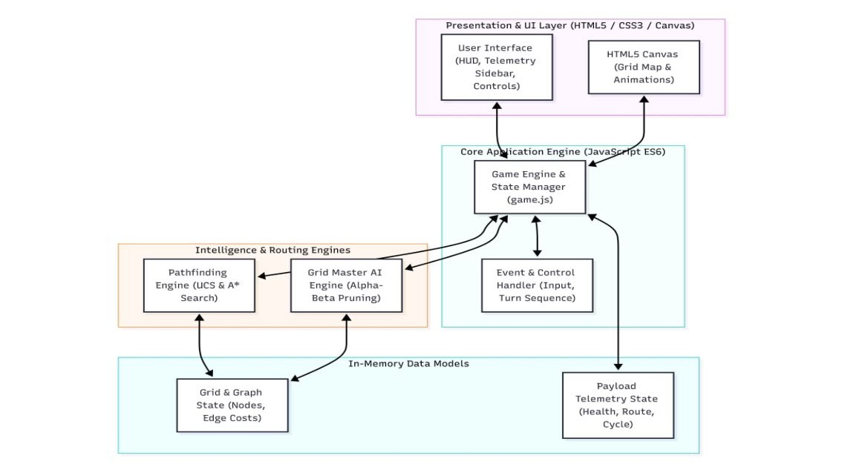
System Architecture

Slide 9
Methodology
Problem formulation
State: Position of payload (x, y) and enemy threat units on the grid.
Initial state: Origin Node (0, 3) with 100 % Payload Integrity.
Goal test: Payload reaches Upload Server (11, 4) with Integrity >0%.
Path cost: Cumulative traversal cost across node types
A* algorithm
Evaluates f(n) = g(n) +
h(n) , where h(n) is
Manhattan distance to the destination.
Alpha-Beta Pruning :
Prunes minimax search branches enabling rapid threat evaluation.

Slide 10
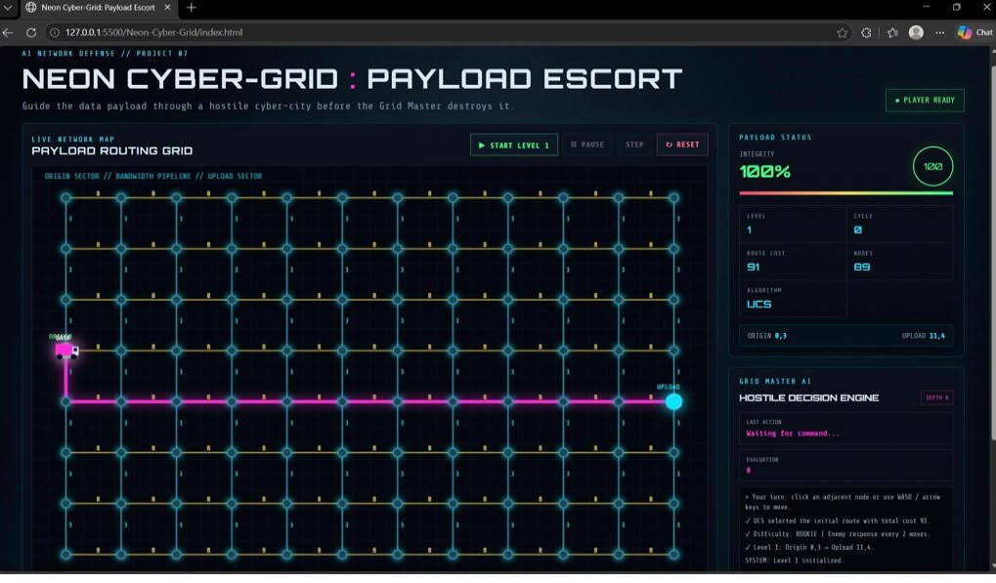
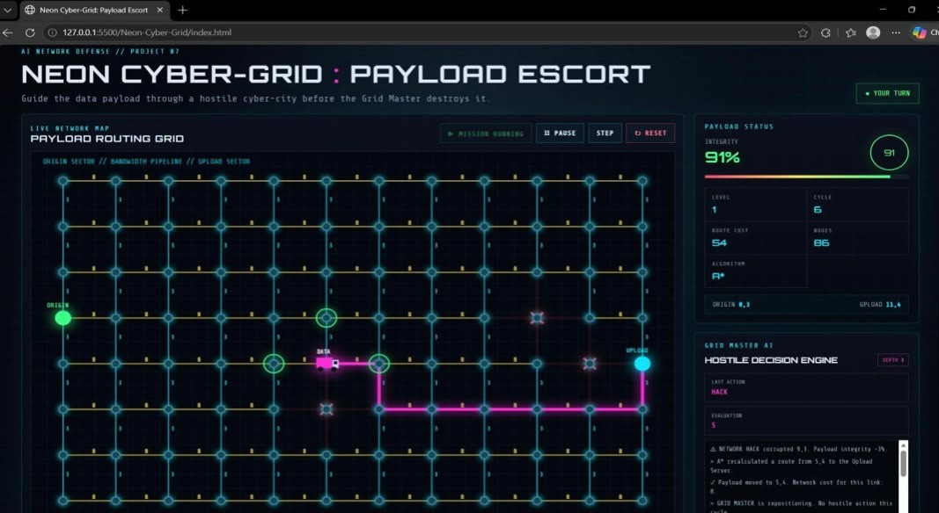
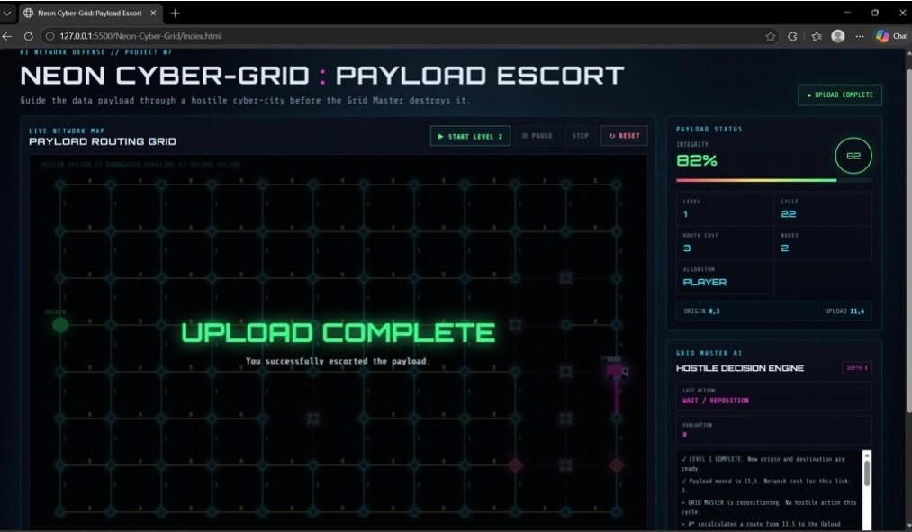
Results

Slide 11
Conclusion
A* finds the optimal shortest walking route on the campus graph and explains every step.
Tested: same cost as Dijkstra for all 1190 place pairs, with fewer nodes explored.
Complete working system in the browser: no ML, no backend, no paid API.
Limitations: not traffic-aware; straight edges approximate curved paths; weak indoor GPS.
Future work: stairs and slope costs, accessibility routes, multiple stops, indoor maps, mobile app.

Slide 12
References
Russell, S. and Norvig, P. (2020) Artificial Intelligence: A Modern Approach, 4th Edition, Pearson.
Hart, P. E., Nilsson, N. J. and Raphael, B. (1968) 'A Formal Basis for the Heuristic Determination of Minimum Cost Paths', IEEE Transactions on Systems Science and Cybernetics, Vol. 4, No. 2, pp. 100–107.
3. Knuth, D. E. and Moore, R. W. (1975) 'An Analysis of Alpha-Beta Pruning', Artificial Intelligence, Vol. 6, No. 4, pp 293–326.
Cormen, T. H., Leiserson, C. E., Rivest, R. L. and Stein, C. (2009) Introduction to Algorithms, 3rd Edition, MIT Pre .

